Slide 1
IoT based
Intravenous Drip
Monitoring
System
6th Semester Project
Under the guidance of:
Dr. Vijay Kumar Chaurasia

Slide 2
Prepared By -
The following are the names and respective enrollment numbers of the students who have worked in collaboration for the completion of the project.
Prabhakar Kumar - IRM2017008
Vardhan Malik - IWM2017007
Kumar Raju Bandi - IWM2017502
Harsh Gupta - ISM2017501
Prasanna Venkateshan V S - IIT2017101

Slide 3
Abstract:
In the healthcare and medical field, a lot of new devices and technologies are emerging that are making it easier to care for the patients. One of the most prevalent issue had been the Reverse Flow of Blood through the Intravenous drip. This project intents to prepare an automated Intravenous drip system that will reduce the risk of reverse flow of blood.
One of the greatest advantages of the project is the easy interface for users which can be accessed and managed by means of Mobile Applications or Web based interface.

Slide 4
Introduction:
Automation in healthcare is an emerging field unknown to us. In the current era, there is no time for youngsters to concentrate on healthcare as it requires more time and work. In terms of business, it has much profit. By introducing automation, time and stress can be reduced in Nurse/Monitoring person. As we are moving to a future of healthcare, we have to save a person’s health.
There are many disadvantages in the healthcare system like infection control due to assessments of doctor, heart attack due to clot of Air embolism in backflow of blood in intravenous fluid, medication errors due to surgery and clinic respective.

Slide 5
Intravenous therapy is the infusion of fluid substances directly into a vein. IV system may be used to correct fluid imbalances, to deliver machines, for blood transfusion or as fluid replacement to correct. This way is the fastest way to deliver medicines or fluids. Therefore, it is necessary to monitor treatment through IV therapy.
This project propose an IR Sensor and Load Sensor based IV Drip Monitor System, instead of the prevalent Level Sensor based system. This is done to avoid any contact with the fluid for safety and clinical purpose. The connectivity and alert system intends to ensure increased ease of access and maximum security for the patients.

Slide 6
Problem Statement:
The project proposes an IoT based automation for Intravenous Drip monitor system, that will keep track of the level of drip fluid over a cloud database and provide alert to concerned people in case of any situation demanding immediate care. The system will be connected to the users with a mobile application and also a web based interface, where real-time updated data will be available from the database. The monitoring system is intended to be a low cost and safe healthcare assistance alternative that would not only increase the safety of patients but also aid in reducing the risks and work-load for the nurses.

Slide 7
Literature Review:
Study by Mithuna and Kalpana(2015) [1] in their paper developed a low cost RF based automatic alerting and indicating device. It works on the principle that IR sensor output voltage level changes when intravenous fluid level is below certain level. They implemented a comparator to continuously compare the IR output with the predefined threshold.
Our project is the extended version of the above proposed project with the additional mechanism of flow control using a hardware valve.

Slide 8
Study by Rao and K. Evangili (2019) [3], in their paper built a wireless sensor network based liquid level and drop count measuring system using ultrasonic sensor HC-SR04, LM35 temperature sensor,and Texas Instruments CC3200 based on Energia IDE and written in embedded C language.
Study by Bhavasaar and Praveena (2019) [4] in their paper developed a method that lowers the chances of heart attack due to air embolism and reduces difficulties involved in IV therapy using beam load cell and amplifier INA125P supported by arduino as software.

Slide 9
Study by Zhang and J.Li (2018) [5], in their paper built an infusion monitoring system that monitors the real-time drop rate and the volume of remaining amount of drug during the intravenous infusion by proposing an architecture to connect intelligent things using Narrowband IoT (NB-IoT).
Study by Assogba and Motamed(2016) [2] in their paper proposed a hybrid architecture over a ubiquitous platform for a patient monitoring system for detection of risky situations and alert using collaborative sensor network with the help of WiMax and RFID technology.

Slide 10
Methodology and Implementation
Intravenous system(IV) is a method of injecting medicinal fluids directly into a vein. It is the fastest way to administer medicines as it delivers it directly into the bloodstream.It is used for various functions such as fluid volume replacement, to correct electrolyte imbalances, to deliver medications, and for blood transfusions. Intravenous infusions are commonly referred to as drips.
If the fluid level in the Intravenous system falls below a certain level it can induce reverse blood flow in the system from the person’s veins to the saline solution bottle. The reverse blood flow happens when the pressure in the bottle is less than the pressure in the veins and this forces the blood from the veins to the bottle.
It should be noted that the whole project comprised of two sections : Hardware and Software. Due to COVID-19 pandemic and complete lockdown, we were unable to work upon the Hardware Section, but have presented a detailed description of the structure and workings of the Hardware components.

Slide 11
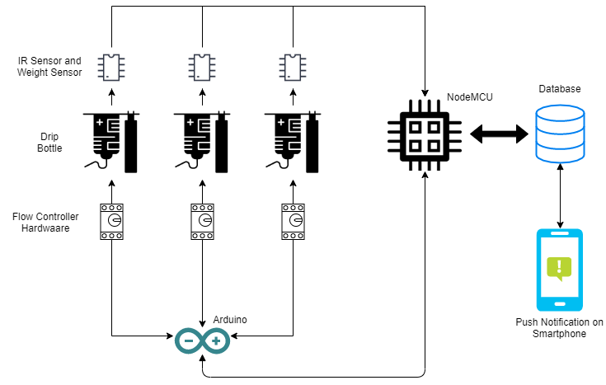
4.1 Overview of the Model

Slide 12
4.2 Measurement of Fluid Level
To measure the amount of fluid remaining in the system we use weight sensors such as Load cells which send out proportional electric signals to weight. We also use an IR sensor (Transmitter and Receiver) to measure the amount of fluid present so as to reduce the error margin. We take the reading of the level of fluid and send the values to NodeMCU.
The measurement of the Fluid Level has been proposed to be done using two different methods:
Using Load Cells
Using IR Sensor

Slide 13
4.2.1 Measurement of Fluid Level using Load Cell
For the use of Load Cell, we propose the use of any miniature Load Cell, but having a dependable response, using which we can hang the Drip Bottle. The Load Cell will continuously measure the weight of the bottle and depending upon the fluid that has been used in the drip, if the weight of the drip bottle comes to a threshold, assumed to be 20% here, it send an alert notification for the concerned person to take care of, and if the the weight goes low to, let’s assume 10%, then stops the flow.

Slide 14
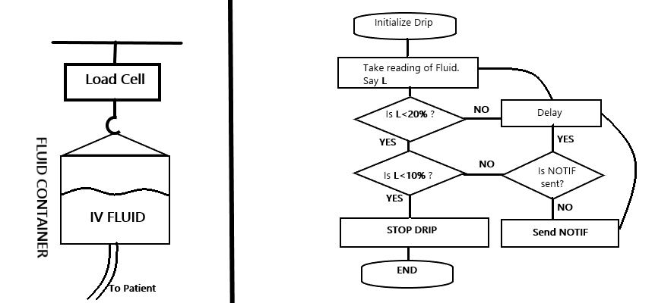
4.2.1 Measurement of Fluid Level using Load Cell

Slide 15
4.2.2 Measurement of Fluid Level using IR Sensor
Since with the use of Load Cell we could only monitor the change of fluid level using weight, using which we can counter Reverse Flow of blood, but to address the problem of stoppage of flow due to clot, we need the flow also to be monitored. We could have addressed the same using Load Cell only but to increase the reliability and reduce the margin of error, we propose the use of IR sensors, precisely SST Liquid Level sensors to continuously monitor the level of fluid and take a note of the rate of flow of the fluid.
With this we also intend to bottle down the possibility of errors as it may be too costly for the patient. The proposed usage of SST sensors and the flowchart of the working are shown in the following slide.

Slide 16
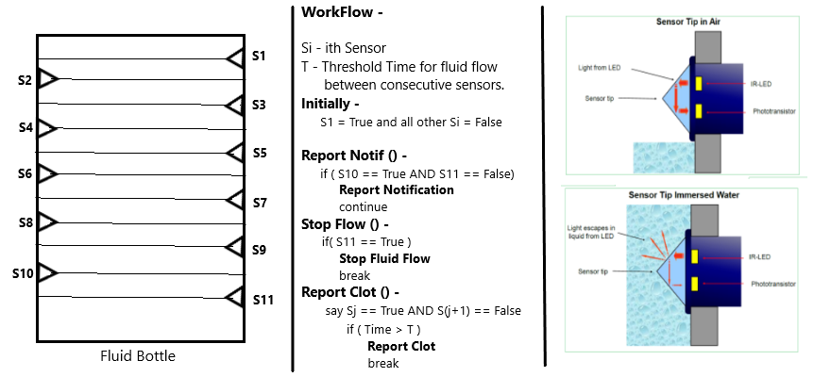
4.2.2 Measurement of Fluid Level using IR Sensor

Slide 17
4.3 Controlling the rate of flow of fluid
The NodeMCU then checks on whether the values are less than the preset value, if it is then NodeMCU sends a signal to Arduino to stop the flow of fluids.To control the flow rate we propose to use a valve or we may also use the arduino to control two servo motors which then turn the pipe into an U shape and stop the flow of fluid. We use arduino only for the control of the servo motors as NodeMCU cannot provide enough power to control the motors.
The flow rate can also be controlled from the mobile application, if an signal is sent from the mobile application then it is stored in the database and it is forwarded to NodeMCU. NodeMCU then again sends the signal to Arduino to control the flow rate.

Slide 18
4.4 Storing the values in the database
The values which the NodeMCU receives from the sensors is sent to the database where it is stored. If an signal is sent to Arduino to stop the flow, then the Arduino also sends an reply signal to the NodeMCU when the flow is stopped. This piece of information is also sent to the database on whether the flow is stopped or not.

Slide 19
4.5 Control from the app
A mobile application is created which is connected to the database. The mobile application shows the amount of fluid present in the system and the flow rate and the estimated time to replace the fluid bottle. The app fetches real time updates from the database, so whenever there is an change in the values, it gets updated in the app too. If we wish to stop the flow then the stop option can be selected which sends the signal to the database and it propagates on.

Slide 20
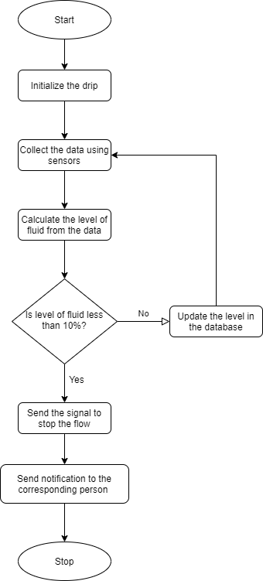
4.6 Flowchart

Slide 21
Software Requirements & Tools:
NodeMCU
Arduino UNO
Weight Sensor (Load Cell)
IR Sensor
Servo motor
Firebase Realtime Database

Slide 22
Final Deliverables
An Android App, which will show the status of each node deployed.
A web app, which will show the detailed view of each node of the system.
Working Hardware prototype with a drip bottle.

Slide 23
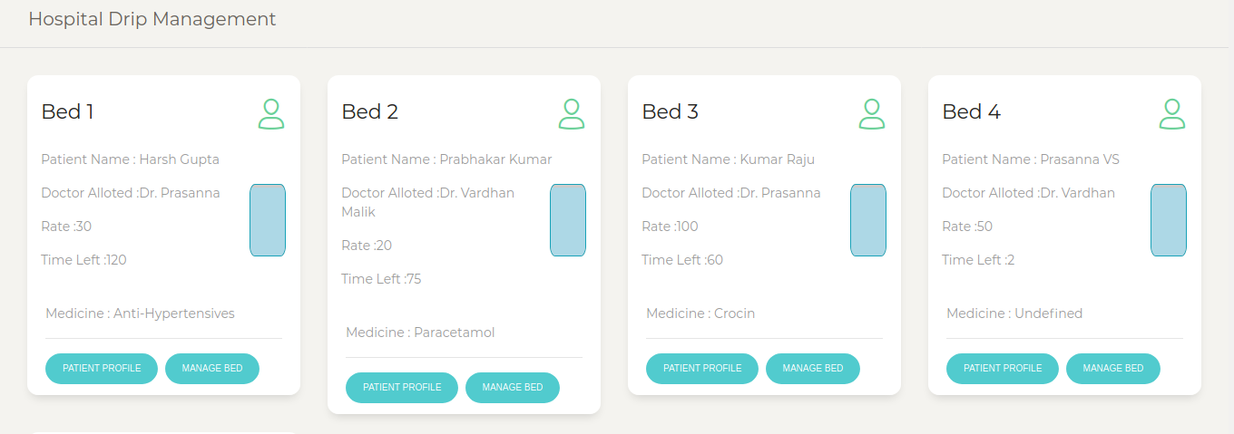
Results
The below image shows the User Interface of the “Hospital Drip Management” website. It’s a dashboard which displays all the beds available in the particular hospital and their current status (vacant/occupied).Each bed has two more attributes namely “Patient Profile” and “Manage Bed”. Due to Firebase, the updates are done in real-time which is very crucial for healthcare software systems.

Slide 24
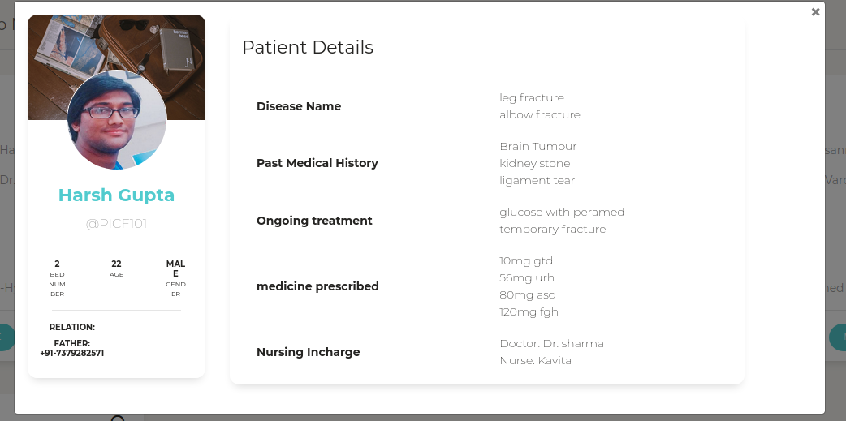
Results
Below is a screenshot of the “Patient Profile” tab from the website:

Slide 25
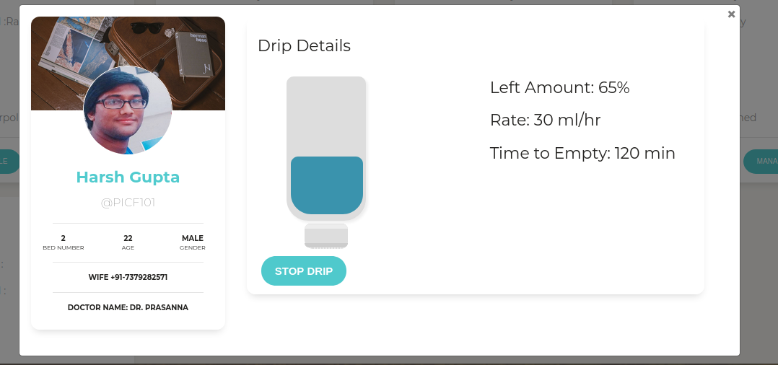
Results
Below is a screenshot of the “Manage Bed” tab from the website:

Slide 26
References:
Priyadharshini, Mithuna, V. Kumar, K. Devi , SuthanthiraVanitha , "Automatic Intravenous Fluid Level Indication System for Hospitals”, International Journal for Research in Applied Science & Engineering Technology (IJRASET) 2015
A.S.R.M. Ahouandjinou, K. Assogba, C. Motamed "Smart and pervasive ICU based-IoT for improving intensive health care ", December 2016 International Conference on Bio-engineering for Smart Technologies (BioSMART)
K.Rao ,K. Evangili Supriya , "Design and Development of IoT Based Intravenous Infusion System ", September 2019. Part of LNEE , volume 569
M.K. Bhavasaar ,M. Nithya ,R. Praveena ,N.S. Bhuvaneswari ,T. Kalaiselvi , "Automated intravenous fluid monitoring and alerting system ", July 2016 IEEE Technological Innovations in ICT for Agriculture and Rural Development (TIAR)
H. Zhang, J.Li, B. Wen, Y. Xun, J. Liu “Connecting Intelligent Things in Smart Hospitals Using NB-IoT ”, 2018 IEEE Internet of Things Journal pp. 1550-1560
Indian Healthcare Industry Report by India Brand Equity Foundation dated December,2019.
Intravenous Drip Monitoring System @ http://iijsr.com/data/uploads/24.pdf
V.Ramya, B.Palaniappan, Anuradha Kumari “Embedded patient monitoring system” International Journal of Embedded Systems and Applications (IJESA) Vol.1, No.2, December 2011

